Slide 1
Memory management
Memory hierarchy
Memory organization
Memory management strategies
Memory management techniques
Protection of memory

Slide 2
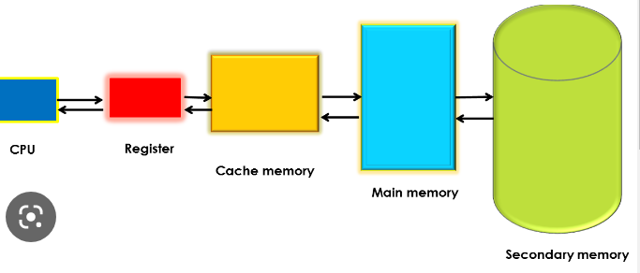
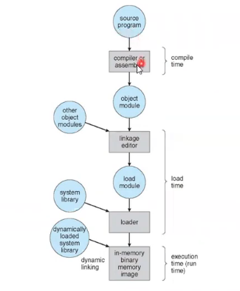
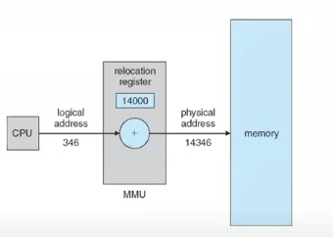

Slide 3
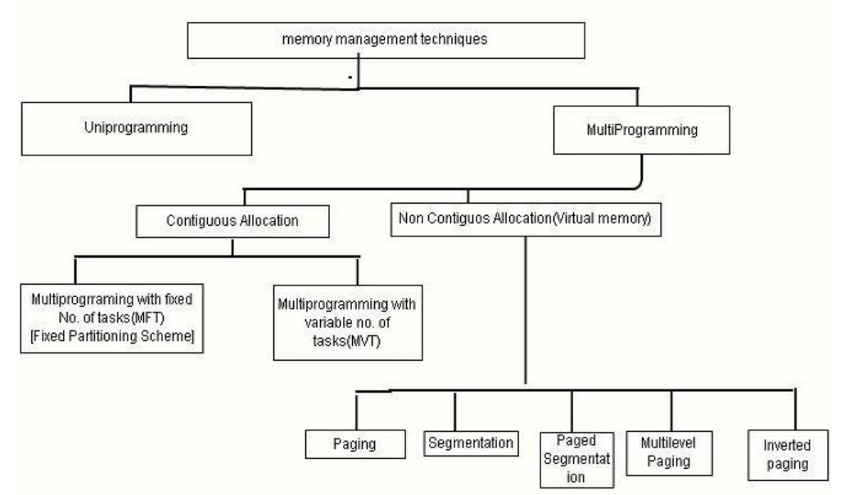

Slide 4
Contiguous allocation
Static / Fixed Partition: main memory is divided into number of static partitions at system generation time
Placement algorithm: equal size partition and un-equal size partition
Fixed partitioning placement algorithm: one process queue/single queue
Dynamic partitioning: partitions are created
dynamically
Placement algorithm
First fit
best fit
worst fit
MM | MM
OS | OS
8M | 8M
8M | 2M
8M | 6M
8M | 8M
 | 12M
MM
OS
4M | P1 3M
6M
8M
10M

Slide 5
Non contiguous allocation
Paging: Paging is a fixed size partitioning scheme, The partitions of secondary memory are called as pages.The partitions of main memory are called as frames, size of frame = size of page, equal fixed size partitions.
Multi level paging
Inverted paging
Segmentation: In segmentation, process is not divided blindly into fixed size pages. Rather, the process is divided into modules for better visualization.
Segmented paging: implements the combination of segmentation and paging.

Slide 6
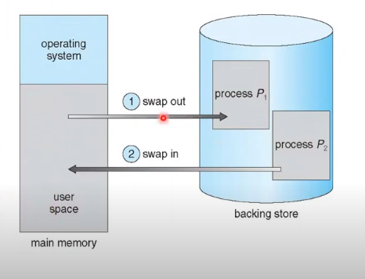
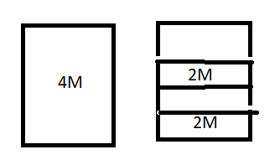
Fragmentation : The processes are loaded or removed from memory , the free memory space is broken into little pieces, process cannot be allocated to memory because remains unused.
1.external fragmentation 2.internal fragmentation
Swapping: a process can be swapped temporarily out of main memory to secondary memory, later again back to main memory

Slide 7
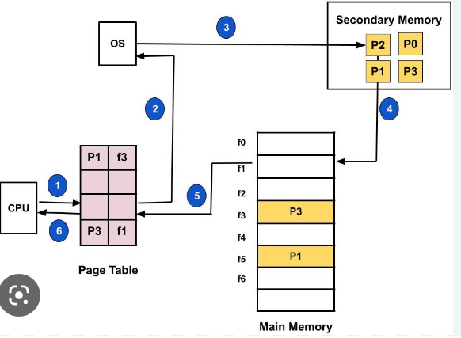
Paging
Demand paging: the process resides in secondary memory and pages are loaded only on demand not in advance
Page fault: page is not present in main memory
Page hit : demanded page is in main memory

Slide 8
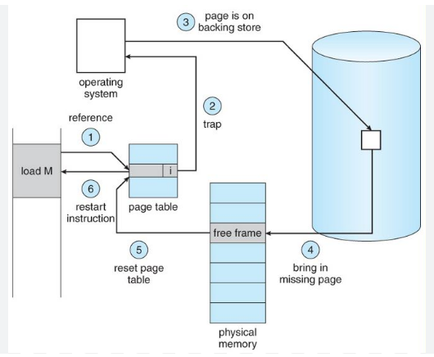
Paging
Logical add = page no+page offset
Physical add = frame no+page offset
Steps in handling page fault:
Page fault rate 0<=P<=1.0
If P = 0,no pagefault (page is found)
P= 1, page not found
Effective Acess Time:
Effective Acess Time = (1-P)*(memory
Acess)+P(page fault overhead+swap
Page out + swap page in+restart over
head)

Slide 9
Page replacement
What happens if there is no free frame?
Sol :Page replacement: whenever page fault occurs, demanded page is not found in MM, then find some page in memory but not really in use, swap it out.
Page replacement algorithms:
FIFO Page Replacement Algorithm - the oldest page for the longest time.
LIFO Page Replacement Algorithm- the newest page that arrived at last.
LRU Page Replacement Algorithm- not been referred by the CPU for the longest time
Optimal Page Replacement Algorithm- will not be referred by the CPU in future for the longest time
Random Page Replacement Algorithm- this algorithm randomly replaces any page.

Slide 10
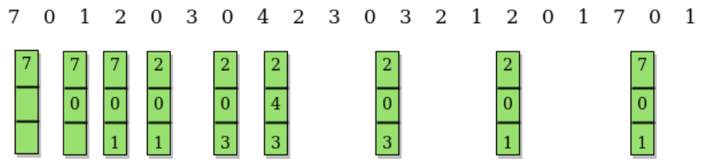
Example : A system uses 3 page frames for storing process pages in main memory. It uses the Optimal page replacement policy. Assume that all the page frames are initially empty. What is the total number of page faults that will occur while processing the page reference string given {7,0,1,2,0,3,0,4,2,3,0,3,2,1,2,0,1,7,0,1} as and Also calculate the hit ratio and miss ratio.
Sol:
No. of hits =11 and no. of misses =9
Page Hit ratio = 11/20*100 = 55%
Page fault ratio = 9/20*100 = 45%

Slide 11
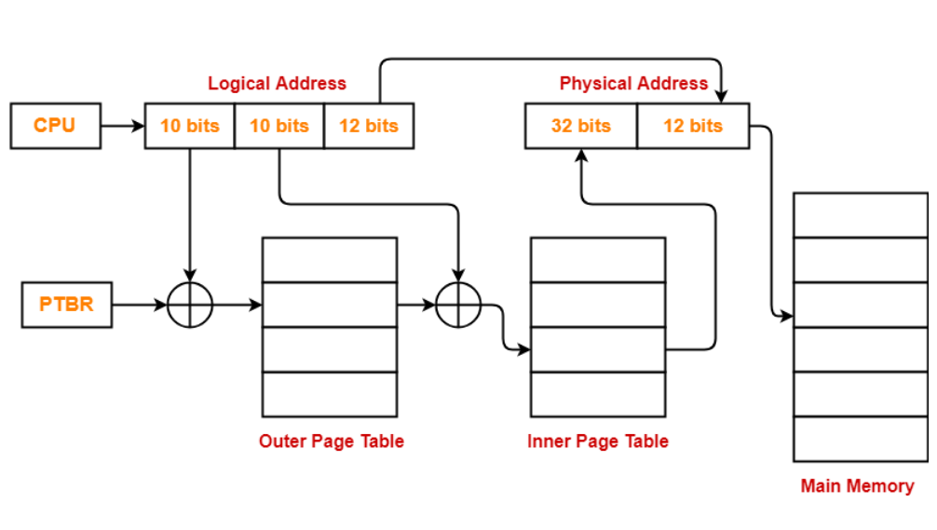
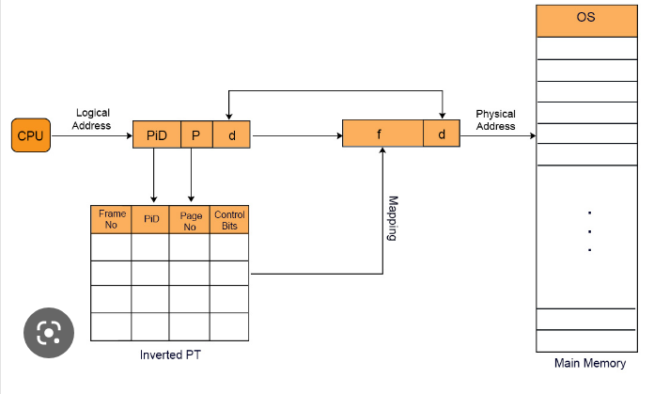
Multi – level paging :The size of page table is greater than the frame size, the page table can not be stored in a single frame in main memory.
Inverted paging: in an inverted page table, for each occupied physical memory frame there is an associated virtual page.

Slide 12
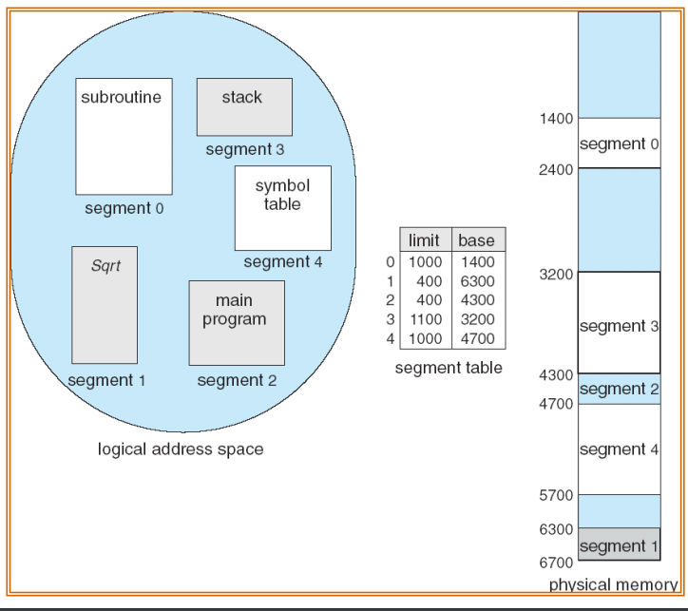
Segmentation
Segmentation : a program is a collection of segments.
logical address refers as <seg name#, offset>
segment table: maps two dimensional physical add base : starting physical address limit : specifies the length of the segment

Slide 13
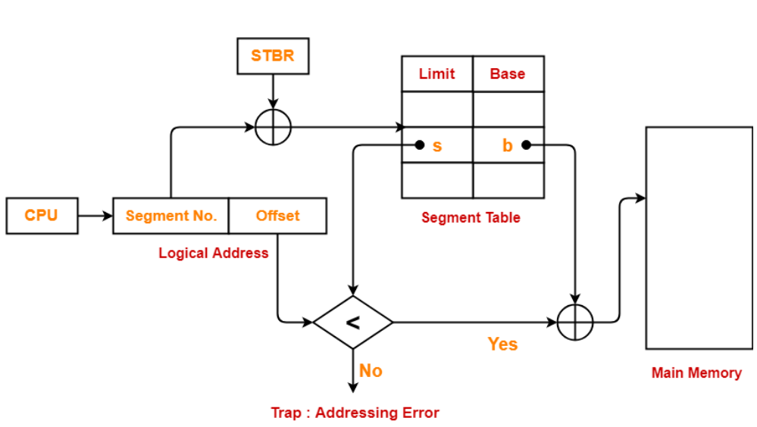
Segmentation hardware: S<STLR(segment table length register)

Slide 14
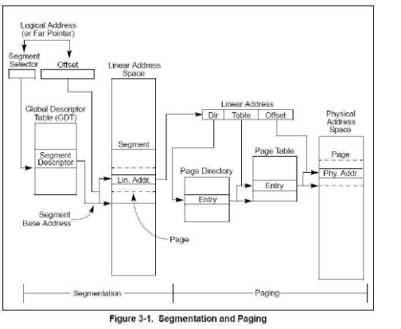
Segmented paging
Cpu –------>segmentation unit----------> paging unit---->physical mem
Intel
pentium

Slide 15
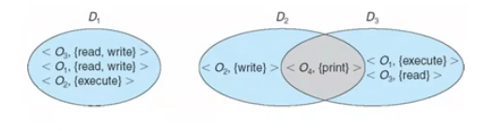
Protection
Thrasing : a process is busy in swapping in and out pages rather than executing user instructions.
Goal of protection: ensure that each object is accessed correctly and only by those processes that are allowed to do so.
Principles of protection : may be static or dynamic and consider grain aspect.
rough- grained management – simpler but least privilege – unix –user-root
fine-grained management – more complex-but more protective-file ack lis
Domain structure: set of access rights
access right is ordered pair
<object name, rights set>

Slide 16
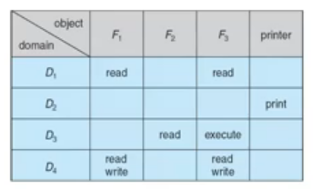
Access matrix : (i,j) is the set of operations that a process executing in domain i can invoke an object.
Domain implementation: domain = user-id
Each file has set uid bit and owner bit, when file is executed set uid =on then user id is set to owner of the file and resets after completion of execution

Slide 17
Implementation of access matrix:
option1 : global table contains- <domain, object, rights-set>
option2: access list for objects – needs of users
option3:capability list for domain – localizing information
option4: lock-key – key matches
First access to an object, capability created and attached to process.
After last access , capability destroyed.
Protection of memory is required to ensure correct operations

